Slide 1
CHAPTER 6: JavaScript and the DOCUMENT OBJECT MODEL
CLO3: Create interactive web pages using current standards-compliant client-side web technologies

Slide 2
Lecture Notes
Contents of lectures are based on the textbook, recommended text, and supplementary material
Please read Chapter Z of the e-textbook from page X to page Y

Slide 3
LECTURE OUTLINE
Introduction
MODELING A DOCUMENT: DOM NODES AND TREES
HTML DOM
Key Terms
DOM CHANGING HTML
DOM APPENDING HTML
HTML DOM - CHANGING CSS
JAVASCRIPT HTML DOM - EXERCISE

Slide 4
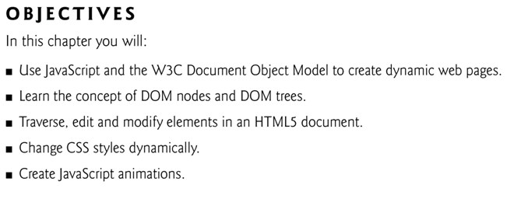

Slide 5
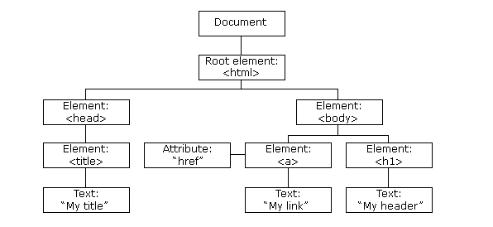
Introduction…
When a web page is loaded, the browser creates a Document Object Model of the page
The HTML DOM model is constructed as a tree of Objects:
Nodes are related to each other through child-parent relationships
A node can have multiple children, but only one parent
Nodes with the same parent node are referred to as siblings
The html node in a DOM tree is called the root node, because it has no parent

Slide 6
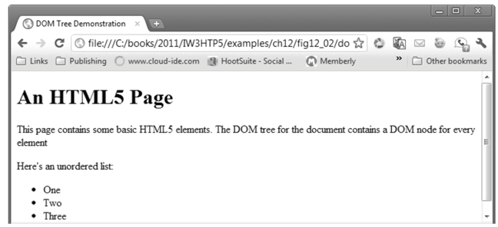
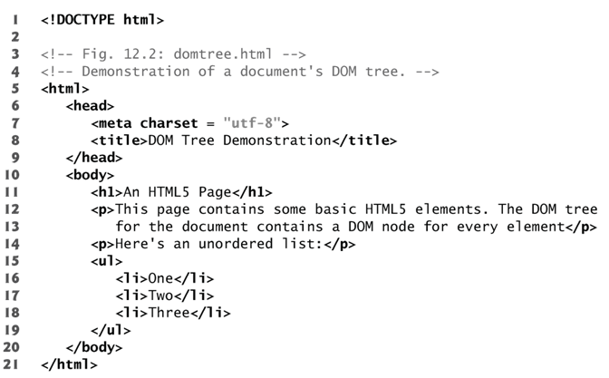
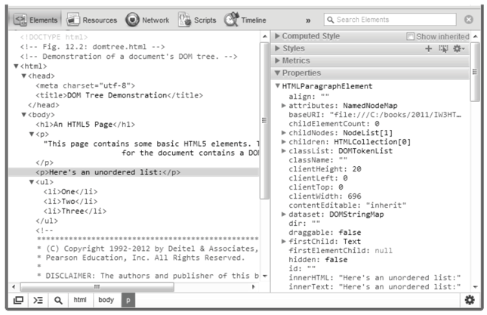
Introduction
How to display the DOM tree
Control+shift+I for Chrome

Slide 7
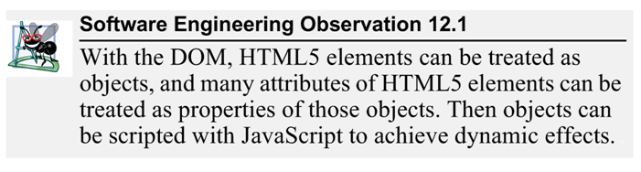
Modeling a Document: DOM Nodes and Trees
The Document Object Model gives you scripting access to all the elements on a web page
With a programmable object model, JavaScript gets all the power it needs to create dynamic HTML:
JavaScript can change all the HTML elements in the page
JavaScript can change all the HTML attributes in the page
JavaScript can change all the CSS styles in the page
JavaScript can react to all the events in the page

Slide 8
W3C HTML DOM Standard
The HTML DOM is a standard object model and programming interface for HTML. It defines:
The HTML elements as objects
The properties of all HTML elements
The methods to access all HTML elements
The events for all HTML elements

Slide 9
HTML DOM
HTML DOM is used to
change the content (innerHTML) of HTML elements
change the style (CSS) of HTML elements
react to HTML DOM events
add and delete HTML elements

Slide 10
DOM-changing HTML…
To change HTML element, HTML DOM offers some methods and properties
HTML DOM properties are values (of HTML Elements) that you can get or set
like changing the content of an HTML element
HTML DOM methods are actions you can perform (on HTML Elements)
like add or deleting an HTML element

Slide 11
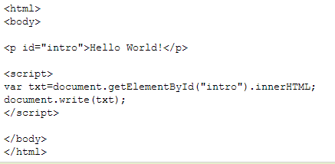

DOM-changing HTML…
The following code gets the innerHTML from the <p> element with id="intro“
getElementById is a method
The most common way to access an HTML element is to use the id of the element
Returns objects called DOM nodes
innerHTML is a property
The easiest way to get the content of an element is by using The innerHTML property
The innerHTML property is useful for getting or replacing the content of HTML elements.

Slide 12
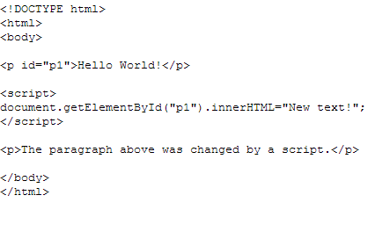
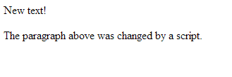
DOM-changing HTML…

Slide 13
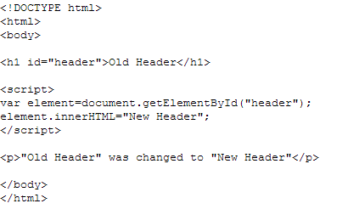
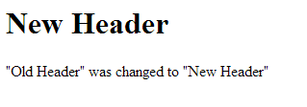
HTML DOM-changing HTML…

Slide 14
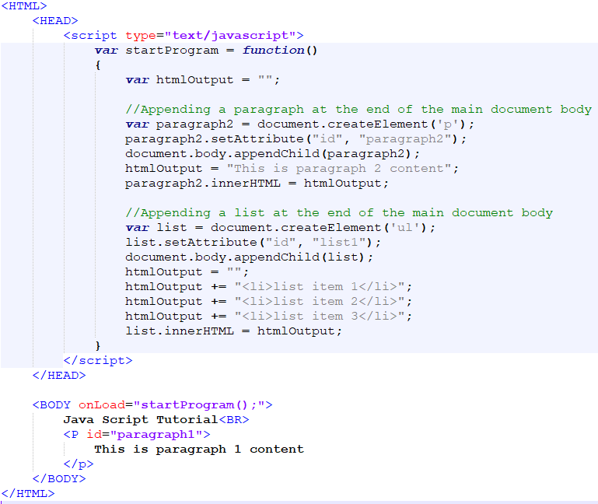
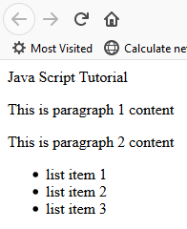
DOM-appending HTML…
JavaScript is able to add new HTML content to a document body.
Create a web page, type the following code, and test it in the browser

Slide 15
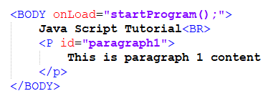
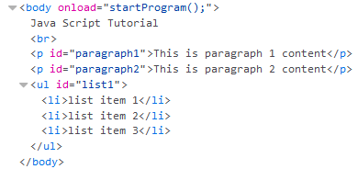
HTML DOM-appending HTML…
The new page will have generated content by JavaScript
Original Page
Generated page after JavaScript program execution

Slide 16
JavaScript HTML DOM - Changing CSS…
The HTML DOM allows JavaScript to change the style of HTML elements
To change the style of an HTML element, use this syntax:
document.getElementById(id).style.property=new style

Slide 17
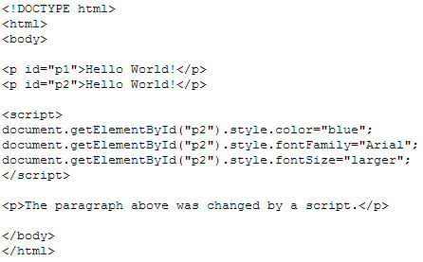
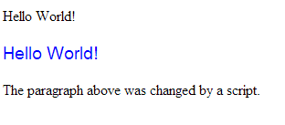
JavaScript HTML DOM - Changing CSS
The following example changes the style of a <p> element:

Slide 18
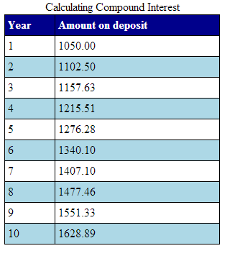
JavaScript HTML DOM - Exercise
Problem Statement
A person invests $1000.00 in a saving yielding 5% interest. Assuming that all the interest is left on deposit, calculate and print the amount of money in the account at the end of each year for 10 years. Use the following formula to determine the amounts:
A=p(1+r)^{n}
P is the original amount invested
R is the annual interest rate
N is the number of years
A is the amount on deposit at the end of the n th year

Slide 19
JavaScript HTML DOM - Exercise
CSS
Change the table background’s color to lightblue
Change the header background’s color to darkblue
Find a way to change the row background’s color to white
JavaScript
Calculate the amount

Slide 20
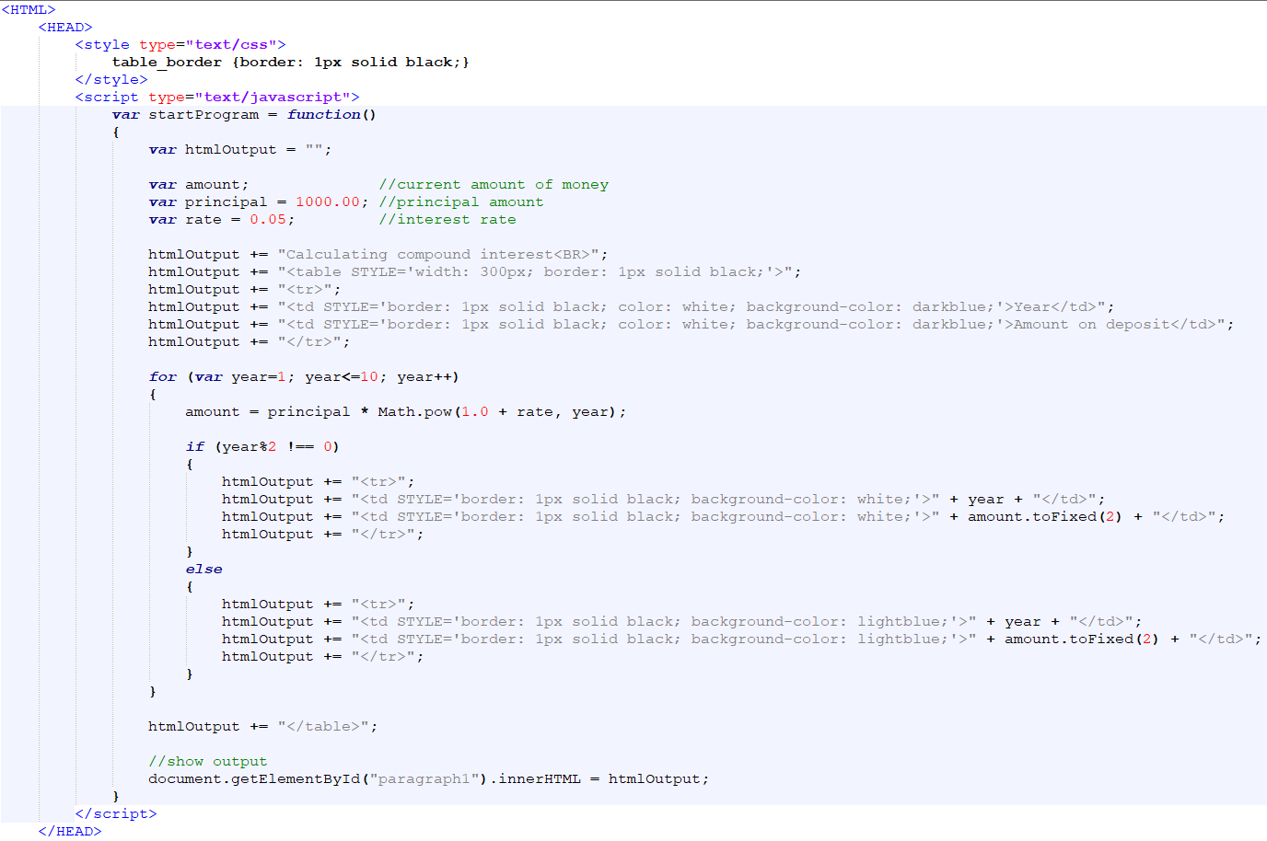
JavaScript HTML DOM - Exercise

Slide 21
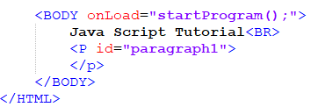
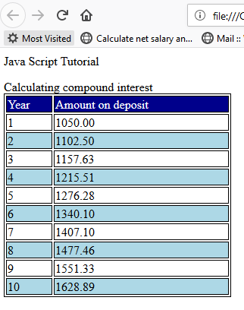
JavaScript HTML DOM - Exercise
JavaScript does not include an exponentiation operator
Math object’s pow method for this purpose. Math.pow(x, y) calculates the value of x raised to the yth power.

Slide 22
KEY TERMS
Document Object model
innerHTML
Element
node
Root Element
Traverse
getElementById
Notes:
Instructor Notes:
Student Notes:

